Slide 1
Trigonometry – The Tangent Ratio
EQ: What is the tan ratio and how can I apply it to right angled triangle?

Slide 2

24
7
30
Trigonometry
Date:
EQ: What is the tan ratio and how can I apply it to right angled triangle ?
Real life applications of trigonometry
Why use Trig?
Carpenters can work out the angle of pitch when building a house roof.
Building surveyors can determine the heights of tower blocks.
Military ships can accurately position potential enemy submarines.

Slide 3

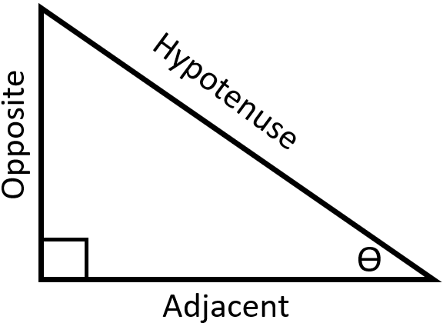

24
7
30
Trigonometry
Date:
EQ: What is the tan ratio and how can I apply it to right angled triangle ?
Opposite side
What is the Tan Ratio?
Adjacent side
Tangent of angle
This is generally shortened to
$$tanθ=\frac{Opp}{Adj}$$

Slide 4
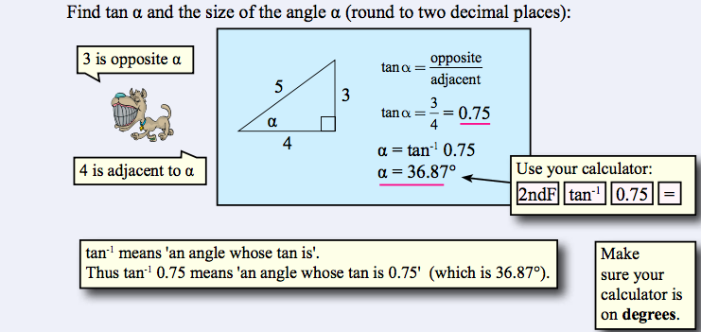
24
7
30
Trigonometry
Date:
EQ: What is the tan ratio and how can I apply it to right angled triangle ?
What is the Tan Ratio and now how do I use it?

Slide 5
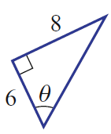
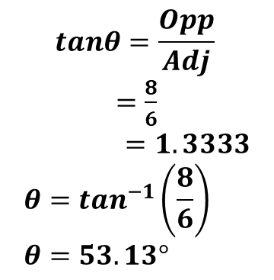
24
7
30
Trigonometry
Date:
EQ: What is the tan ratio and how can I apply it to right angled triangle ?
2nd example
For the example below find the size of the angle θ
What is the Tan Ratio and now how do I use it?
$$tanθ=\frac{Opp}{Adj}$$
$=\frac{8}{6}$
$$=1.3333 \\ θ=\tan^{−1}\left(\frac{8}{6}\right) \\ θ=53.13°$$
Opp
Adj
Angle θ
This is θ = Shift or 2ndF tan⁻¹ (8/6)
Note we use (8/6) instead of 1.3333 because (8/6) is the exact number whereas 1.3333 is an approximation.

Slide 6
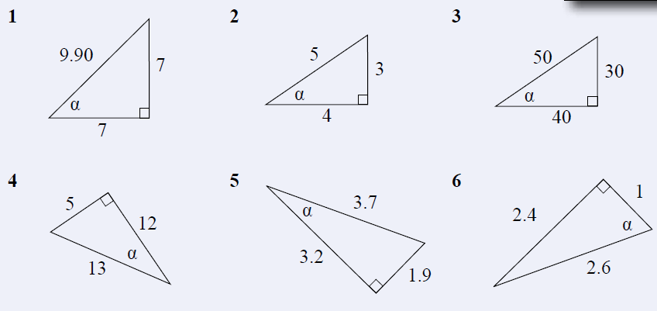
Now complete exercise 17.2 page 231 in the Dwyer Textbook Q1-6, see below and the worksheet 2a Trig – Tan ratio for finding an angle.
Please draw and label each triangle from the text to your Interactive Notebook.

Slide 7
Answers to Ex 17.2

Slide 8
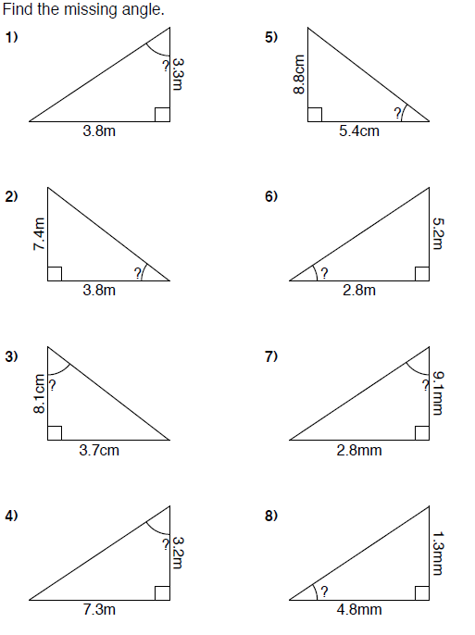

Slide 9
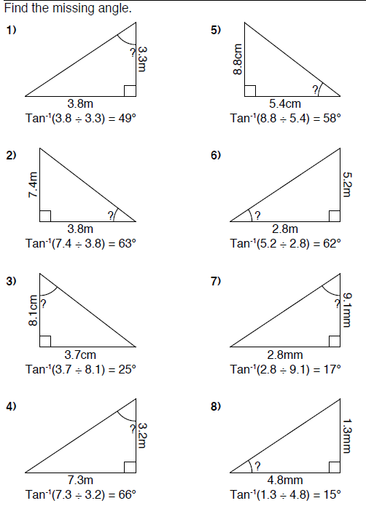
Answers

